Slide 1
Dungeon Positioning System
Elizabeth, Greg, Ray, Phillip, Spencer

Slide 2

Overview
It can be difficult to set up times to meet with all of your friends to play Tabletop Role-Playing-Games, especially if you are spread out over a large area. Thus, our goal was to create a system that would allow people to play TTRPGs with their friends without the need to find a time to meet in person.
The Problem We Address

Slide 3
Subsystems
User Interface
Allow easy control of the system
Maps
Generate, edit, and store maps for the characters to play on
Connectivity
Connect the players to the game session
Database
Store map and other information so sessions can be used multiple times
Quality of Life
Other assorted features to make gameplay easier
Game Log with Dice Roller
Character Sheets

Slide 4
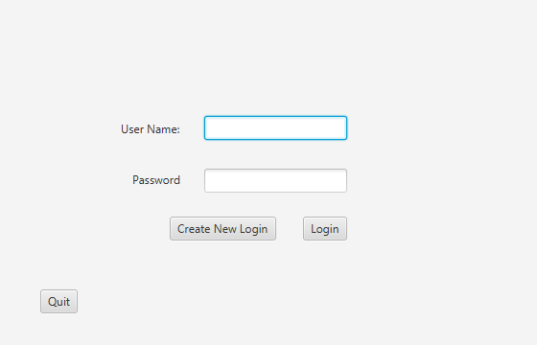
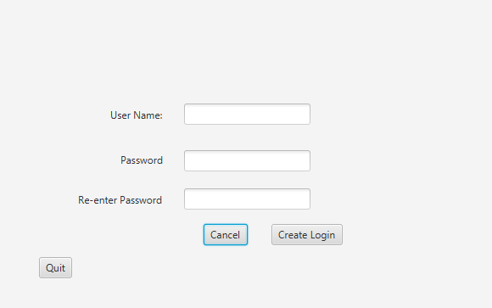
User Interface - Login

Slide 5
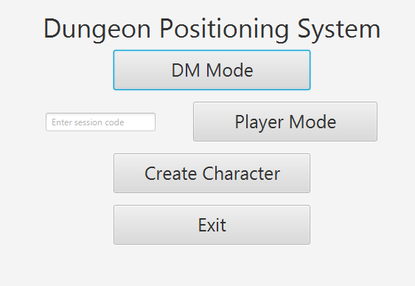
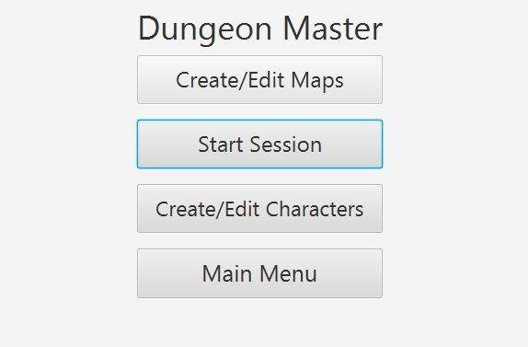
User Interface - Main Menus

Slide 6
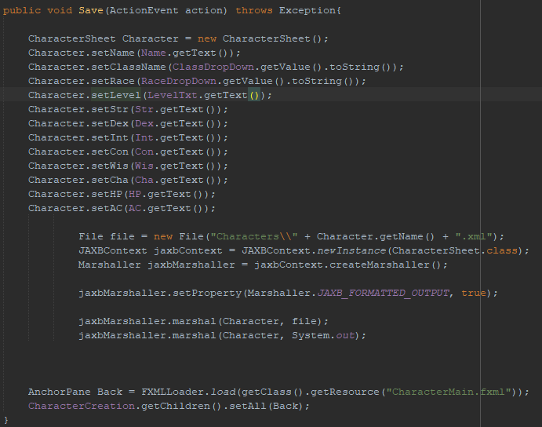
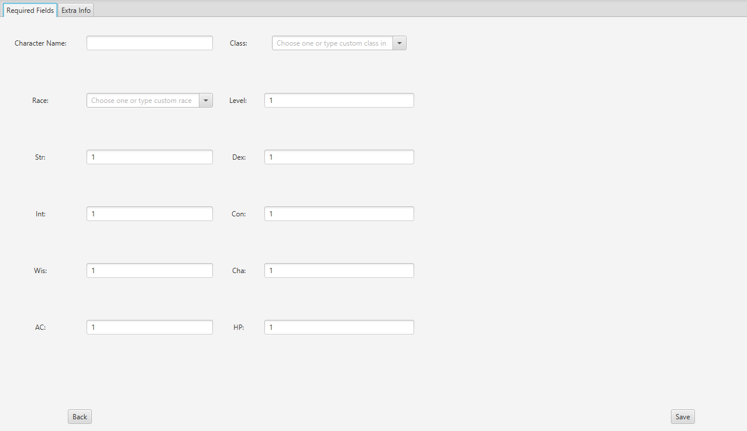
User Interface - Character Creation

Slide 7
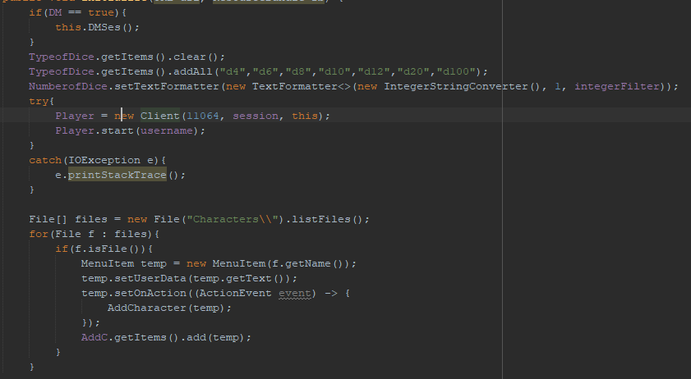
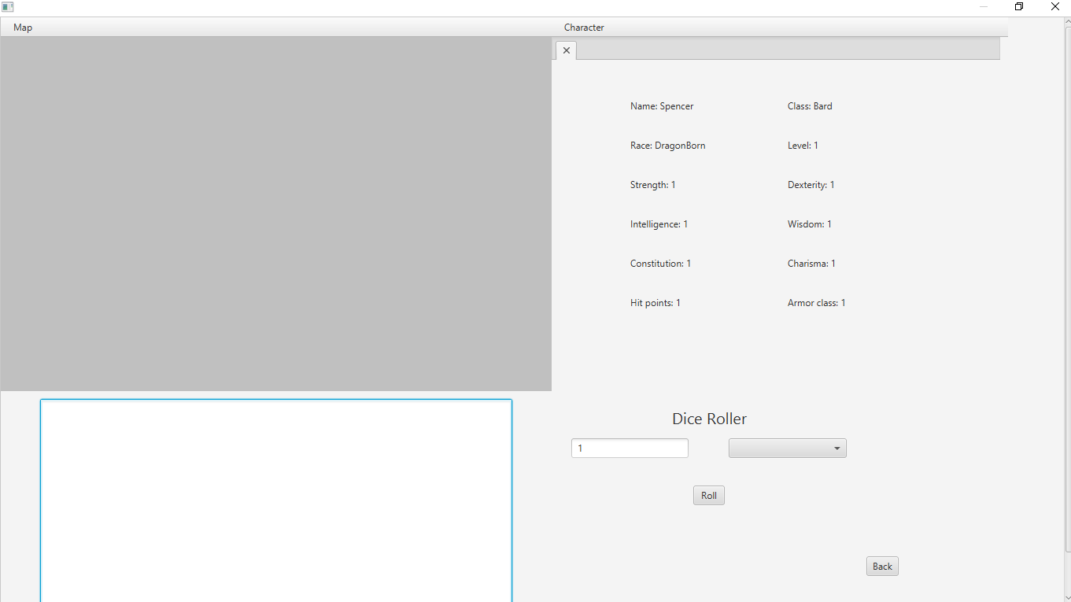
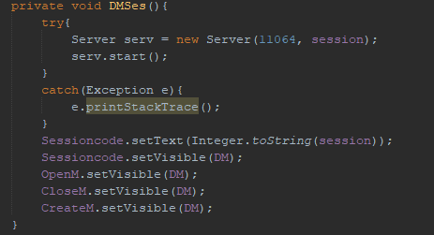
User Interface - Session

Slide 8
Maps
Based on a common algorithm for procedural dungeon generation
Uses random number generation and a bunch of safeguards for room creation and placement
Highly tunable, will be able to take input from the user which will alter the generation (within limits)
Has methods for editing specific tiles

Slide 9
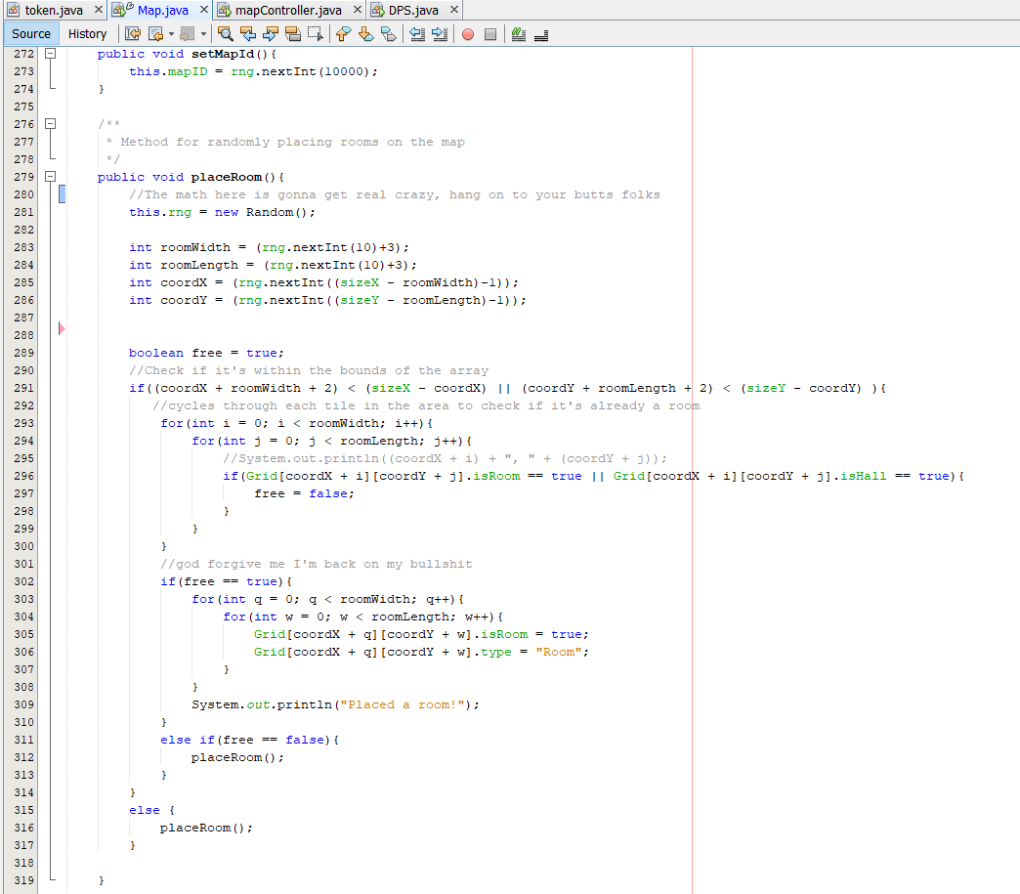
Map Generation Algorithms

Slide 10
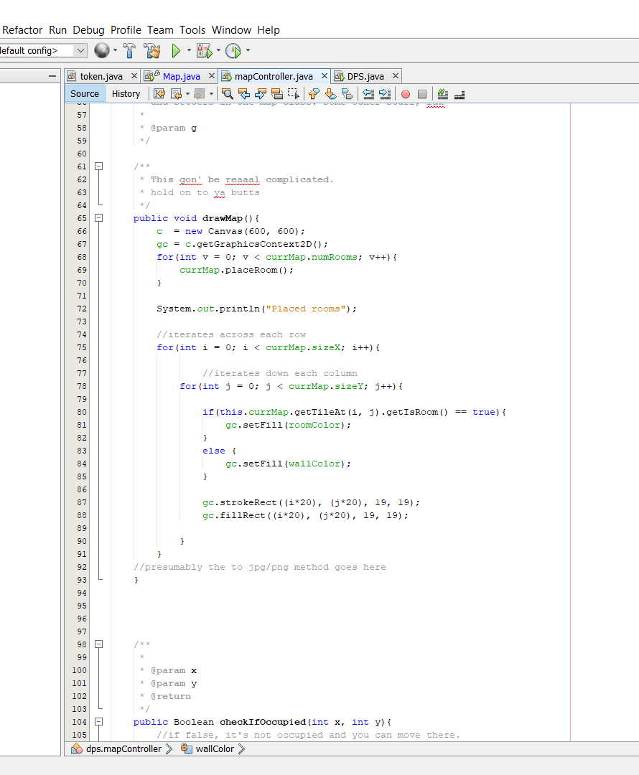
Map Generation Algorithms 2

Slide 11
Server Overview
Our multithreaded server loops constantly looking for connections, and spawns instances of the ServerWorker class in a new thread when it gets a new connection, then adds that instance to an arraylist of ServerWorkers.
When the server is instantiated, it updates the database tuple for the sessionCode and host IP address. This way when players want to connect, they only need a sessionCode, and not the constantly changing IP address of their friend’s computer.

Slide 12
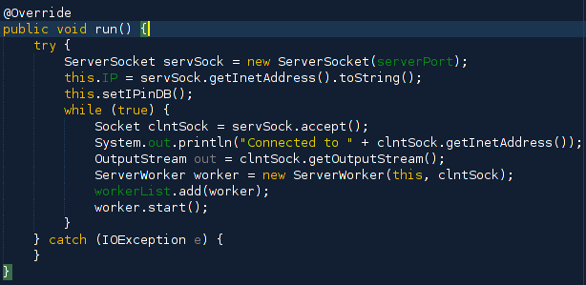

Server run method

Slide 13
ServerWorker Overview
The ServerWorker class handles everything about the connection. It constantly loops fetching input, and handles all cases according to the type of input received, updating the clients as necessary.

Slide 14
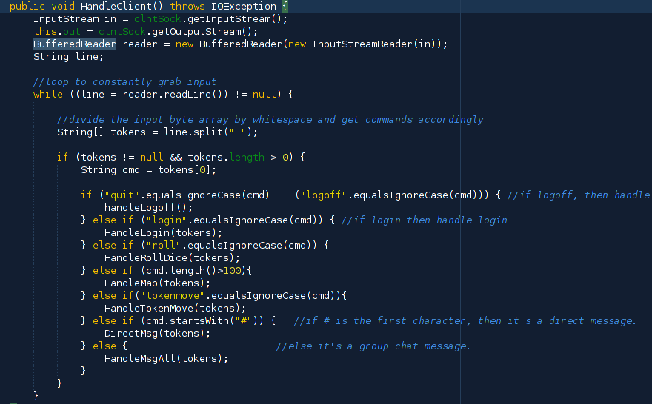

Slide 15
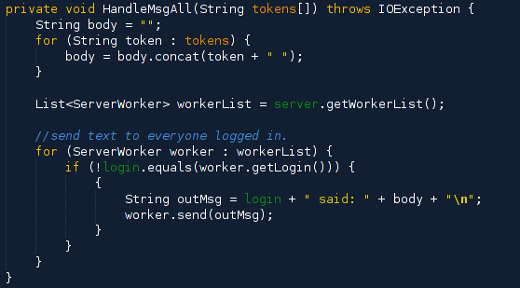
ServerWorker HandleMsgAll method

Slide 16
Client overview
When it connects to the host it spins a new thread to read input from the server, and adds itself to two arraylists of abstract interfaces.
The first interface is used for listening to login/logoff changes from other clients.
The second interface is used to listen for messages.

Slide 17
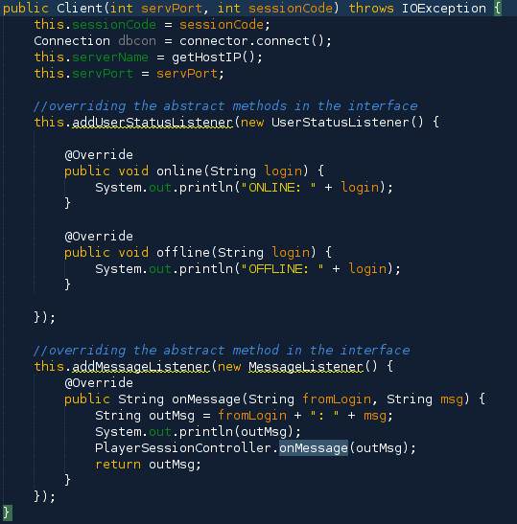
Client
It only takes a port number and a sessionCode to connect to the host.

Slide 18
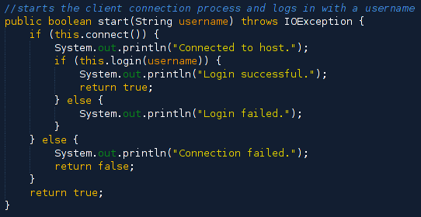
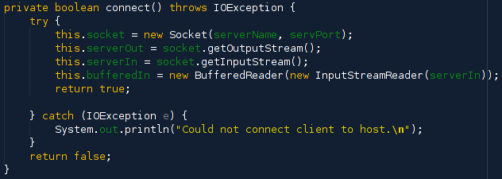
Client start and connect method

Slide 19
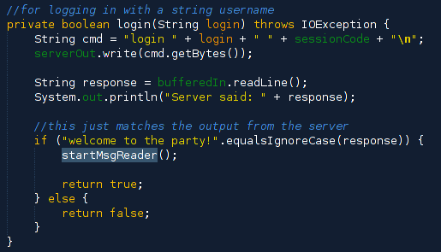
Client login method
This does not authenticate, as you would need to already be authenticated to get here. This only sets the login name in the game log.

Slide 20
Database
Hosted on AWS RDS
Created with MYSql
Coded with Java
Connected by Connector/J driver

Slide 21
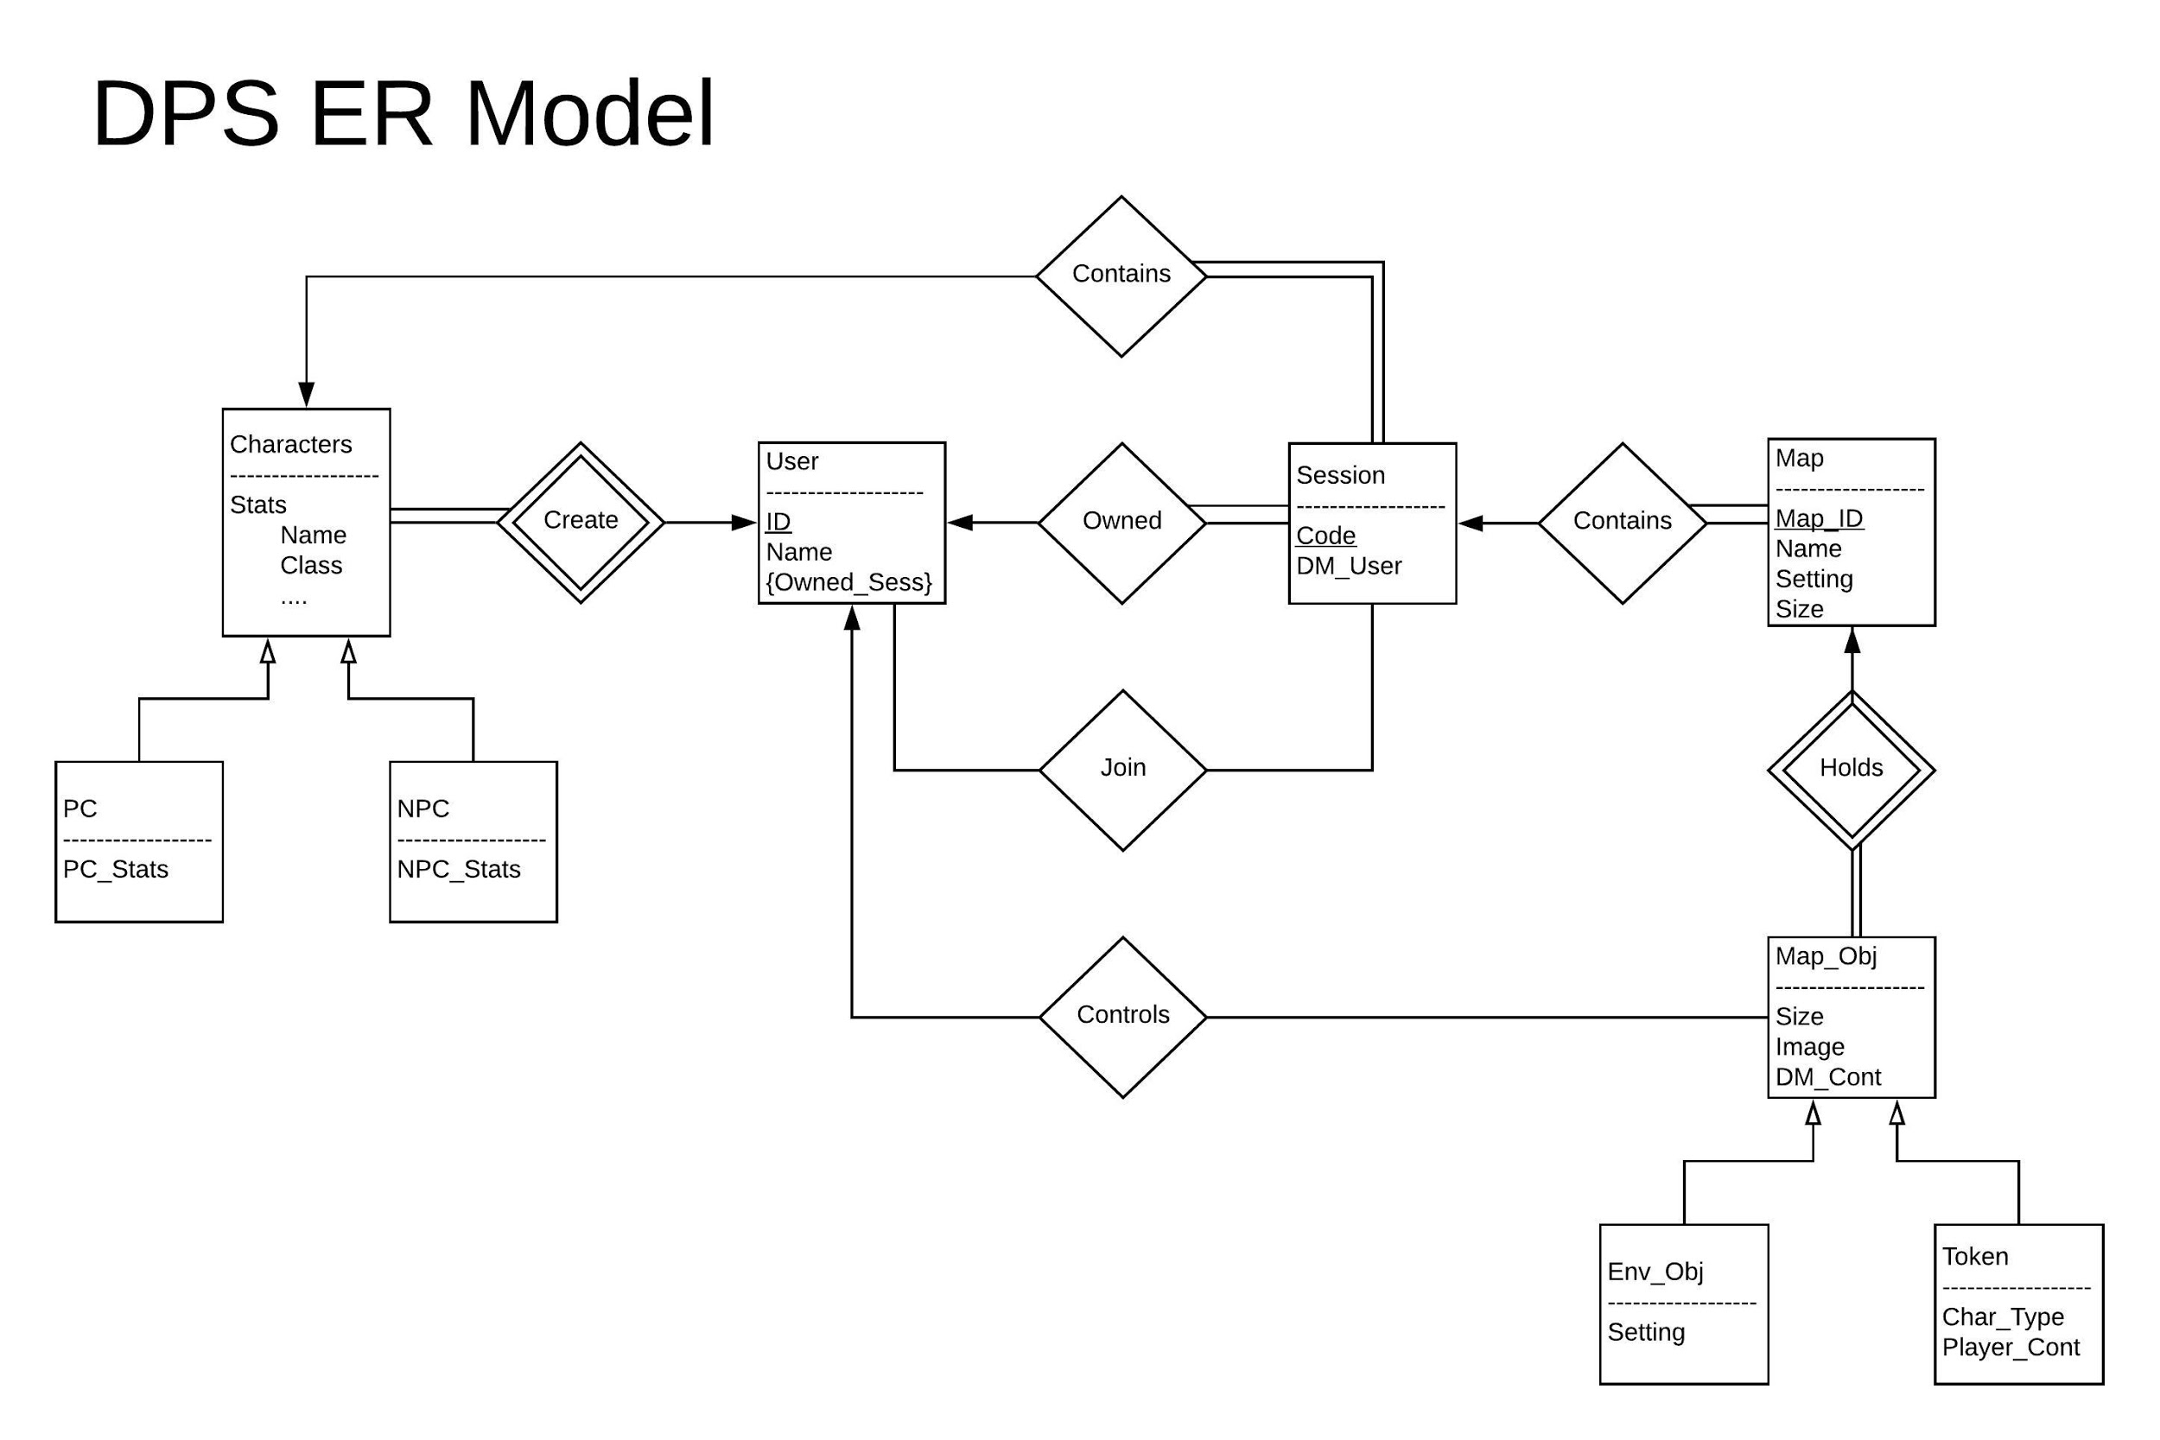

Slide 22
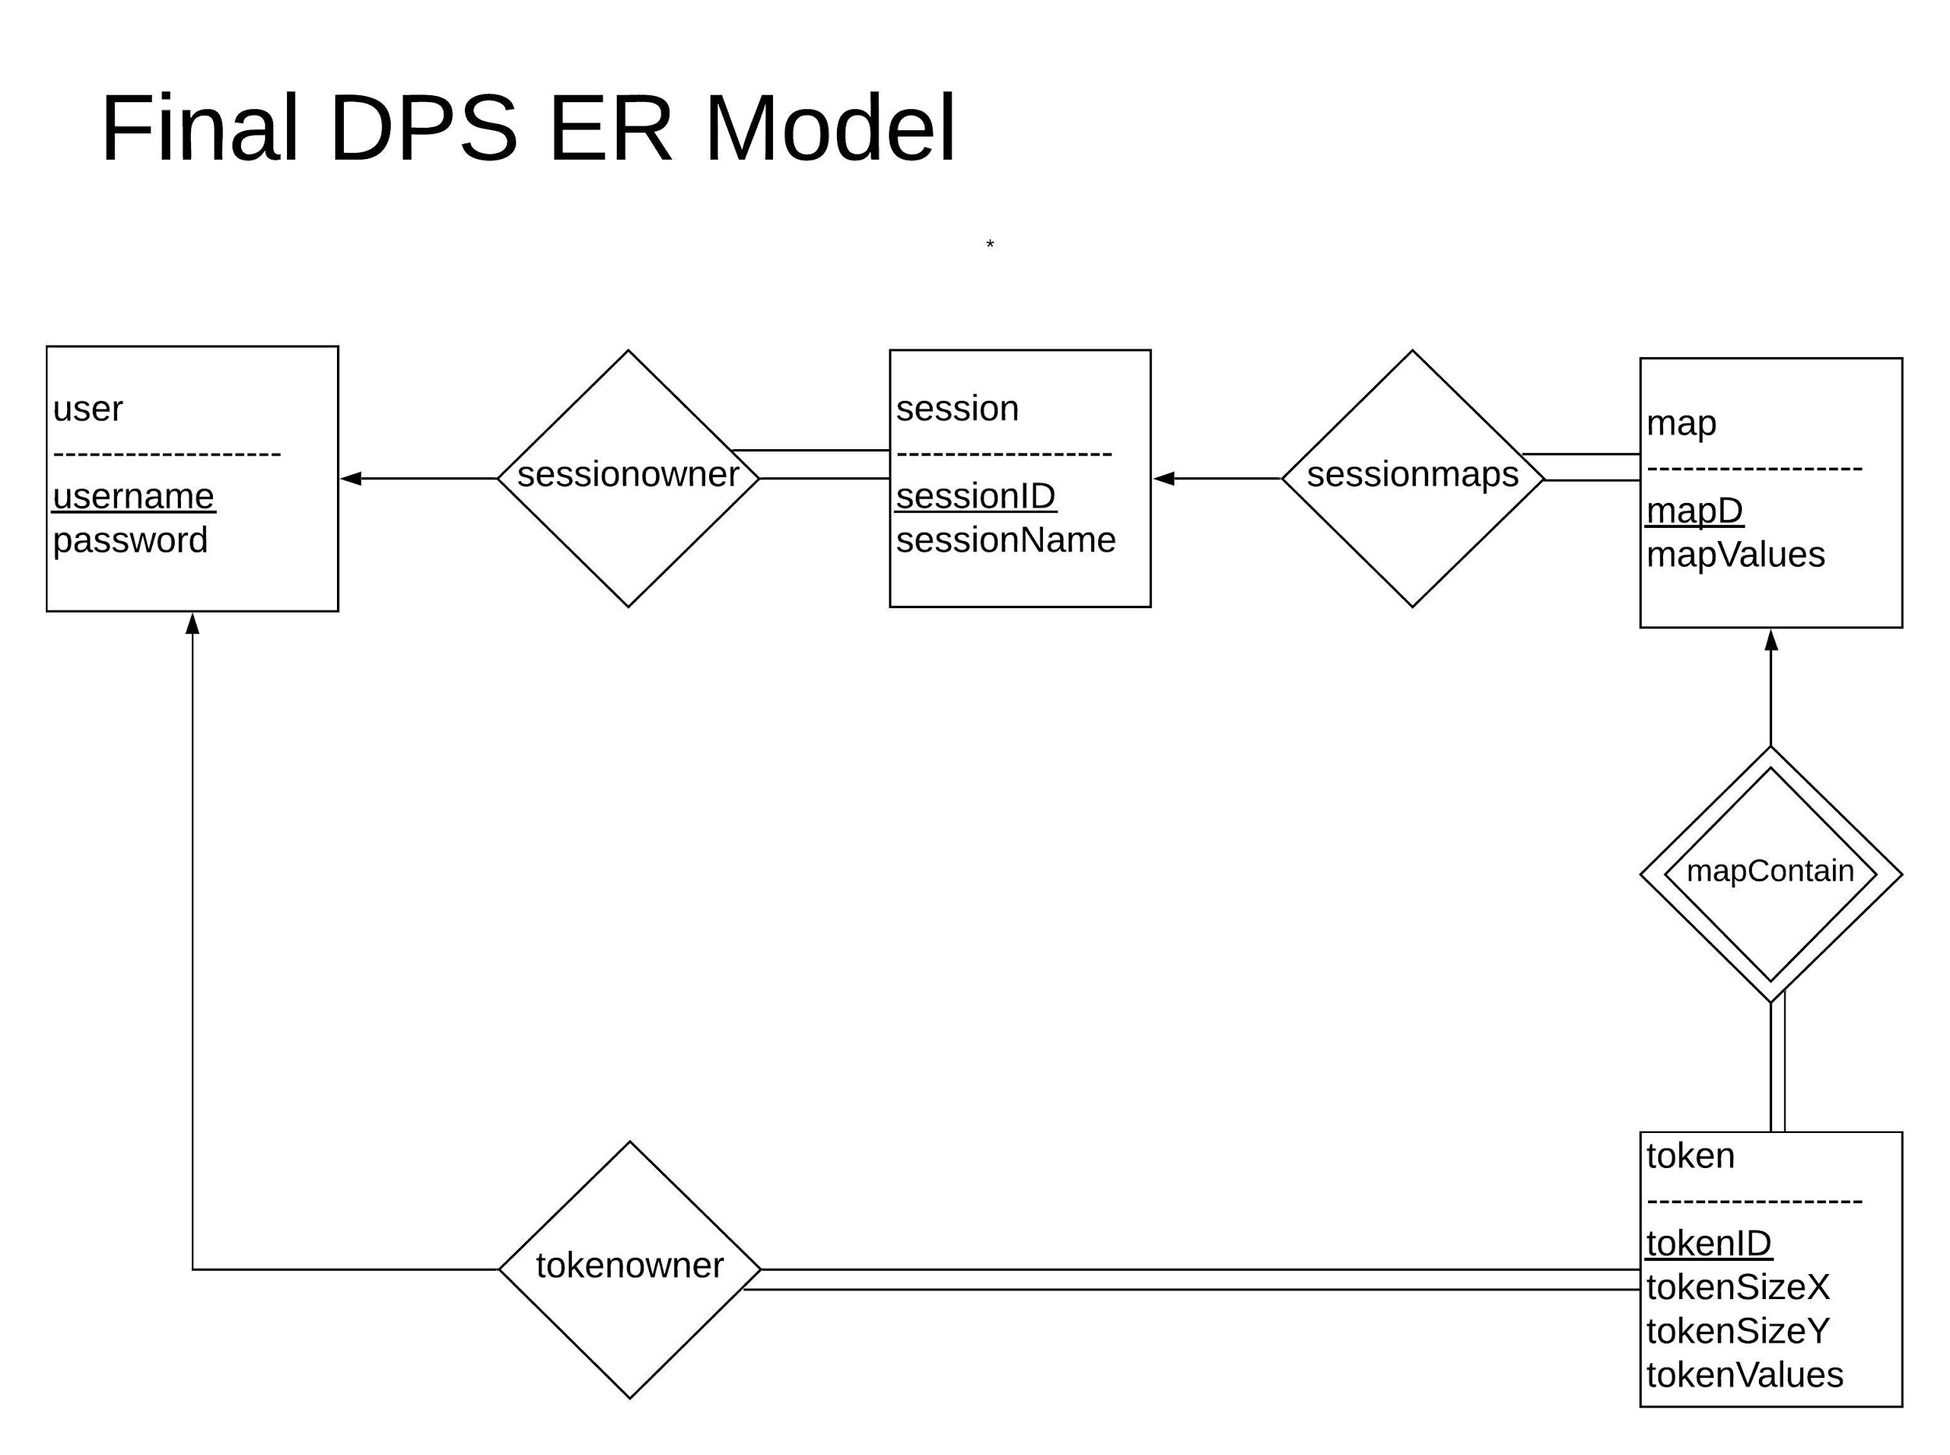
Final ER Model
Singular user type instead of DM/Player seperation
Singular token type instead of Env_Obj/Player seperation
Removed joinedSession table, players of a session are kept track through tokens

Slide 23
Database Design
Objects:
map
mapID
mapValues
session
sessionID
sessionName
token
tokenID
tokenSizeX
tokenSizeY
tokenValues
user
username
password
Relationships:
mapContain
mapID
tokenID
sessionmaps
sessionID
mapID
sessionowner
username
sessionID
IPAddress
tokenowner
tokenID
username

Slide 24
Database Implementation
Connector
User
makeUser
Authenticate
Session
makeSession/deleteSession
setIP/getIP
getSessionList
editSession
Map
makeMap/deleteMap
getMapList
getMapValues/editMapValues
Token
makeToken/deleteToken
getTokenID
getTokenValues/editTokenValues

Slide 25
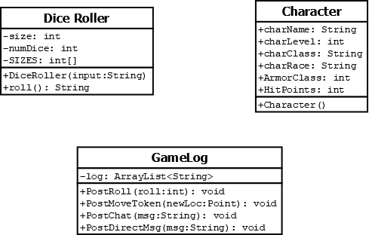
Quality of Life - UML

Slide 26
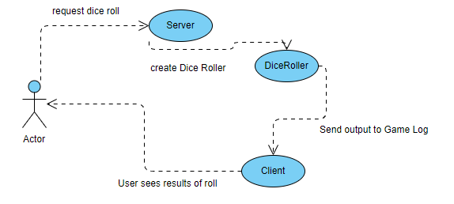
Use Cases - Dice Roller

Slide 27
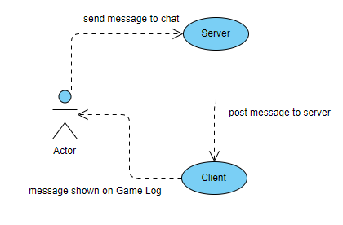
Use Cases - Game Log

Slide 28
Quality of Life
Dice Roller
Integrated into connectivity subsystem
User types roll XdY
X = number of dice to roll
Y = size of die to roll (4, 6, 8, 10, 12, 20, 100)
Game Log
Function encapsulated by connectivity subsystem
Dice Roll results
Public messages
Direct Messages
Character Sheets
Handled directly by UI
Characters saved as XML

